Slide 1
Handwritten Text Reader
Streamlit App for OCR using EasyOCR & TrOCR
Performer: E72-23 group
Topiqov Asilbek

Slide 2
Project Overview
Web app for extracting handwritten text from images
Built with Streamlit
Uses EasyOCR for detection, TrOCR for recognition
Supports English, Russian, and Uzbek languages

Slide 3
Key Features
Image upload and visualization
Configurable OCR confidence threshold
Text region detection with EasyOCR
Handwritten text recognition using TrOCR (transformer-based)
Spell correction using PySpellChecker
Text preview and download

Slide 4
Technical Components
Frontend: Streamlit UI with custom CSS
Backend: PyTorch, EasyOCR, TrOCR
Preprocessing: Cropping detected text regions with padding
Wordlist loading with encoding fallback

Slide 5
Dependencies
Python: torch, transformers, easyocr, opencv-python-headless
Streamlit for UI
pyspellchecker for spell correction
System: tesseract-ocr, libsm6, libxrender1, etc.

Slide 6
Project Files
app.py – Main Streamlit app
requirements.txt – Python packages
packages.txt – System dependencies for deployment

Slide 7
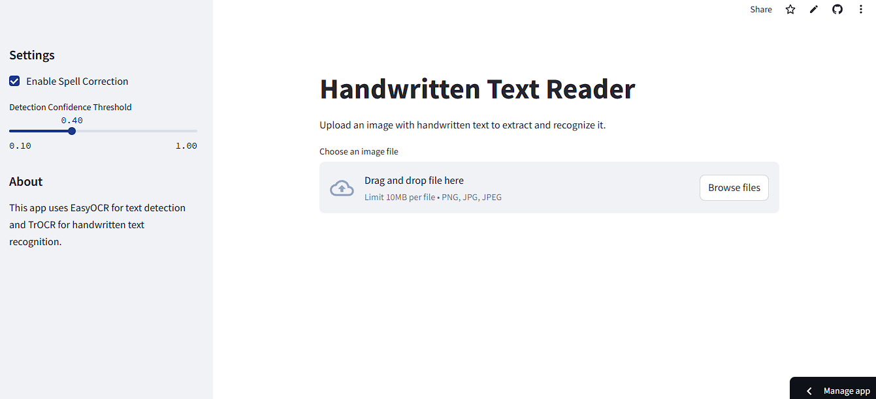
App Interface Screenshot

Slide 8
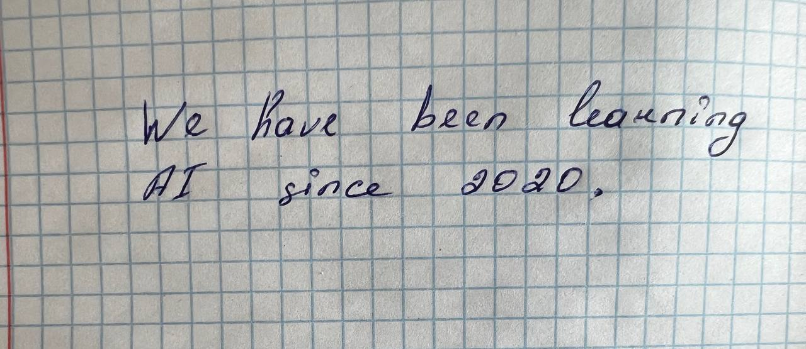
Sample Handwritten Input Image

Slide 9
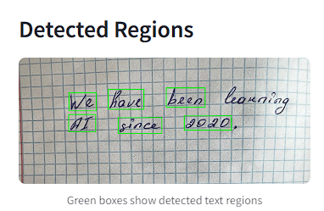
Detected Text Regions (EasyOCR)

Slide 10
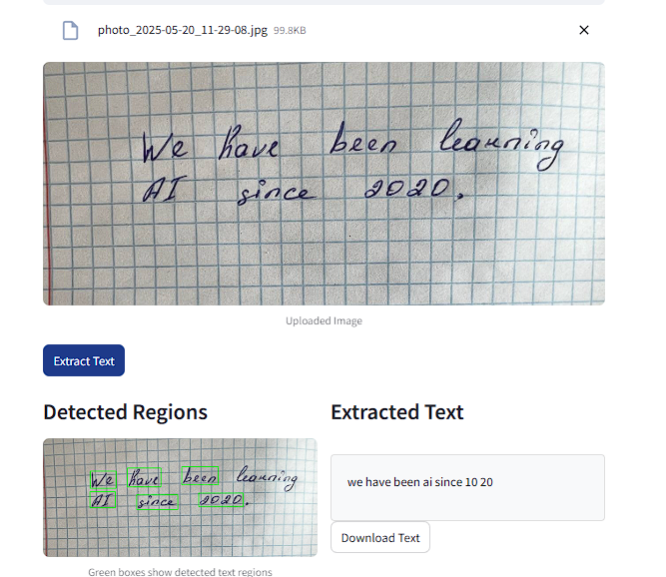
TrOCR Text Recognition Result

Slide 11
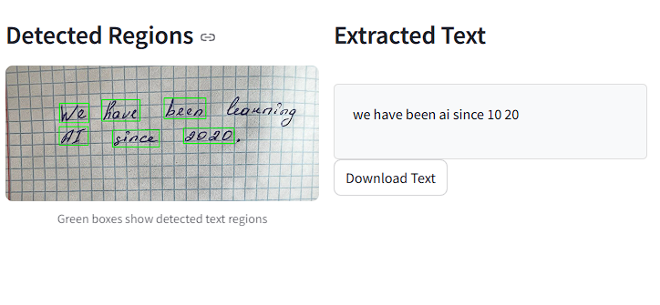
Final Output with Corrections

Slide 12
Thank You

